Slide 1


Jenkins
Presented By: Jyothirmai Kesanapalli

Slide 2

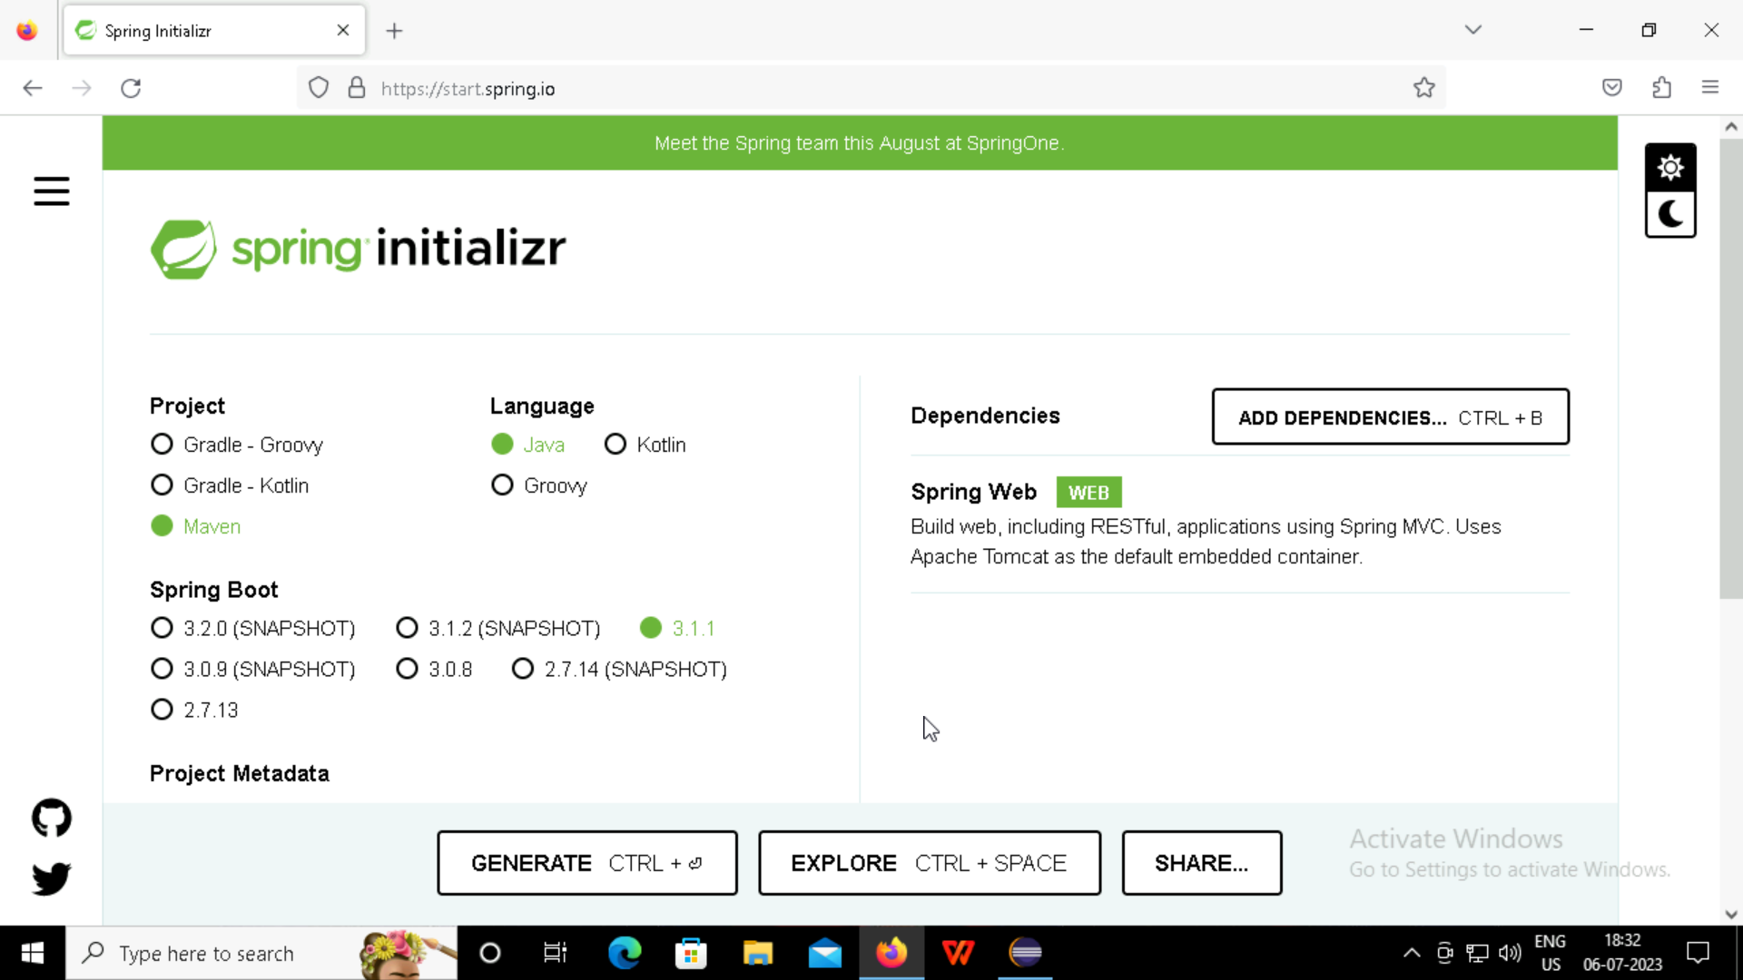
Spring Initializr:
Spring Initializr is a Web-based tool that generates the Spring Boot project structure.
In spring initializer, the project will be generated with the spring web dependencies.

Slide 3
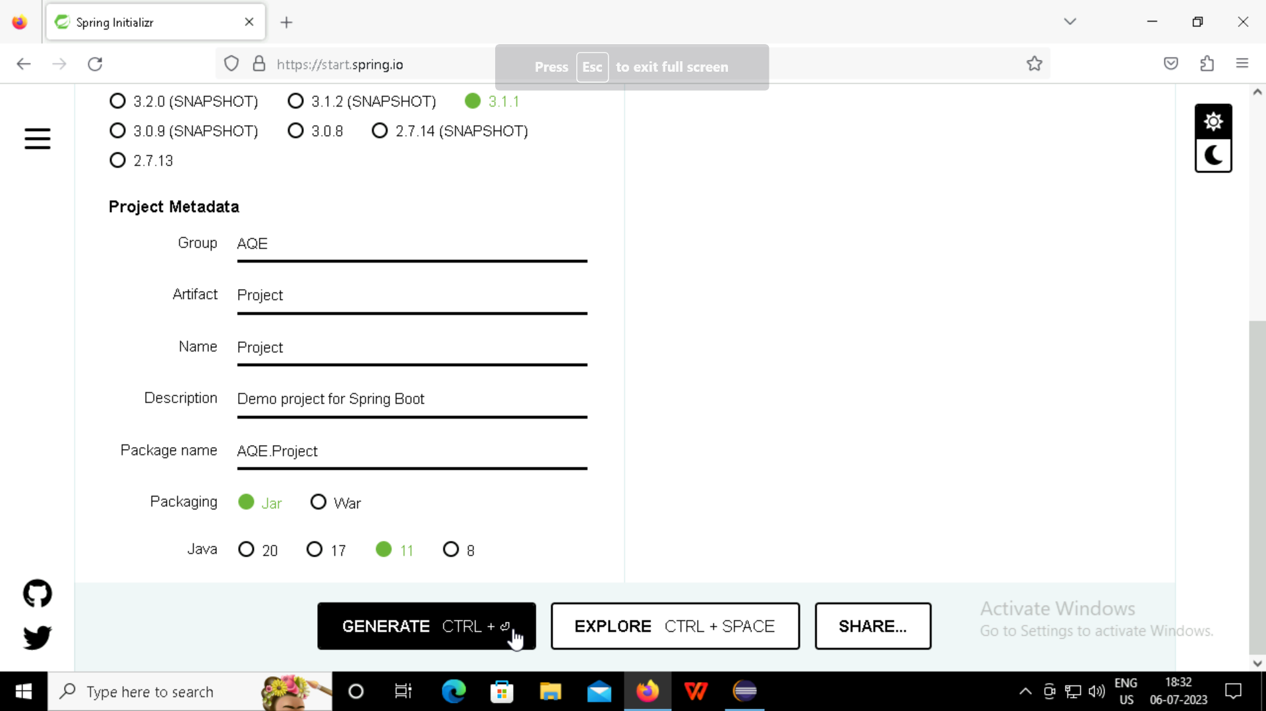

Slide 4
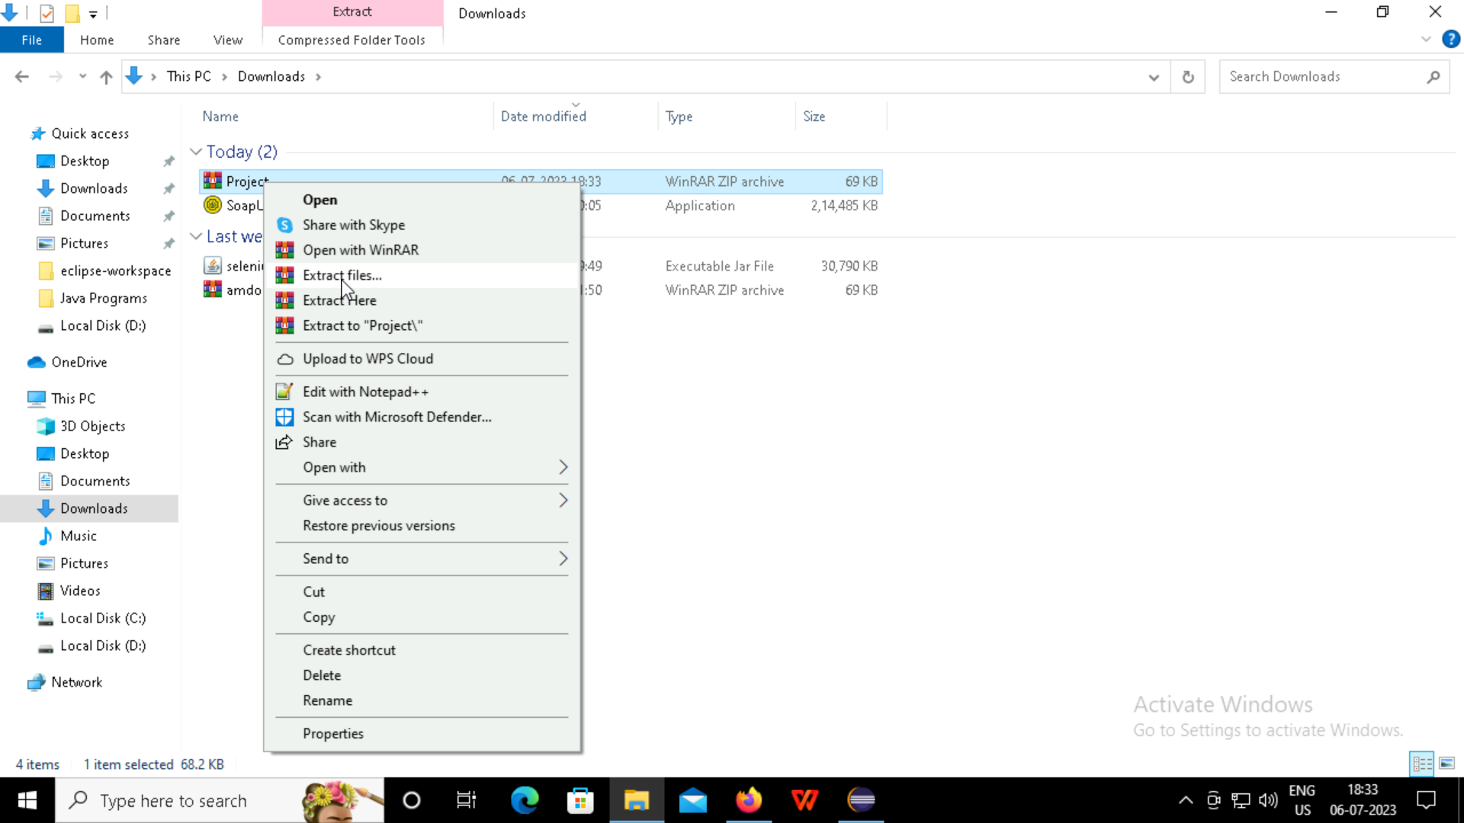
Generated project extract to our eclipse workspace

Slide 5
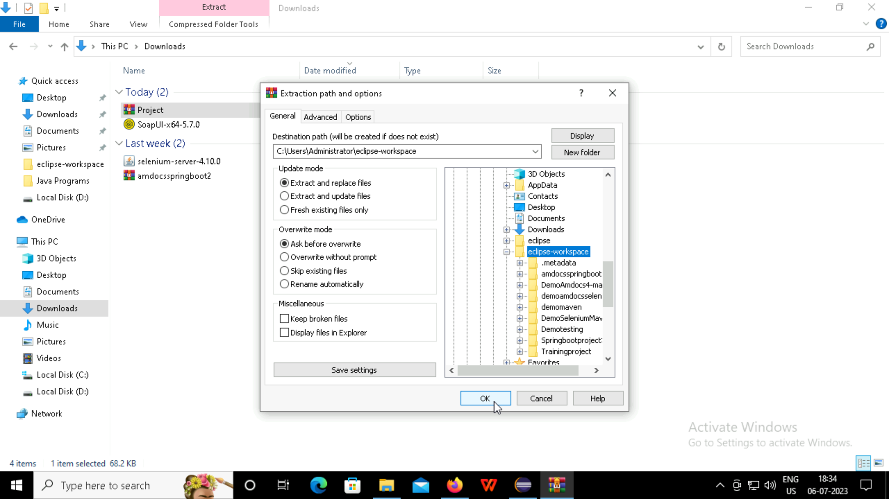

Slide 6
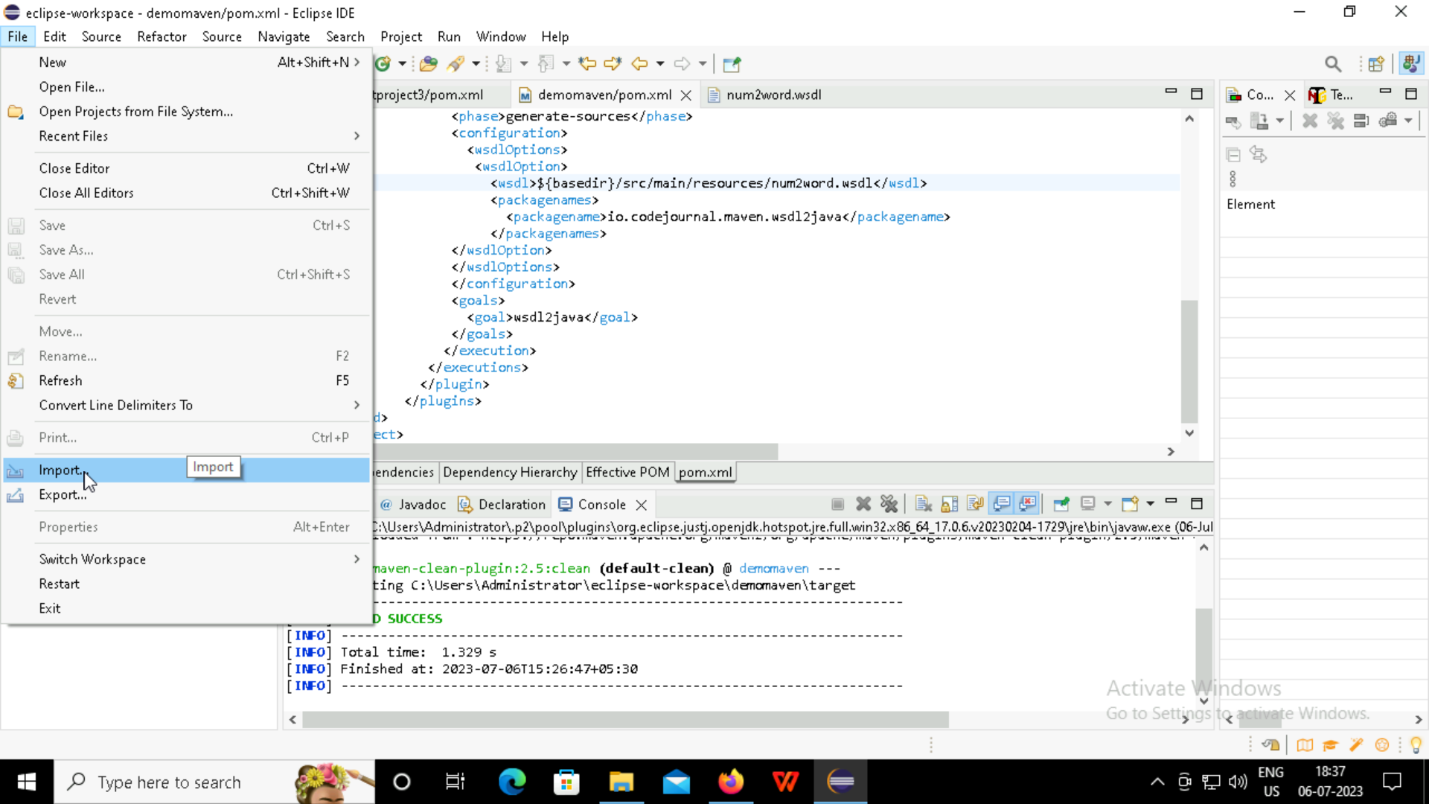
Spring project import into the eclipse with the Existing maven project.

Slide 7
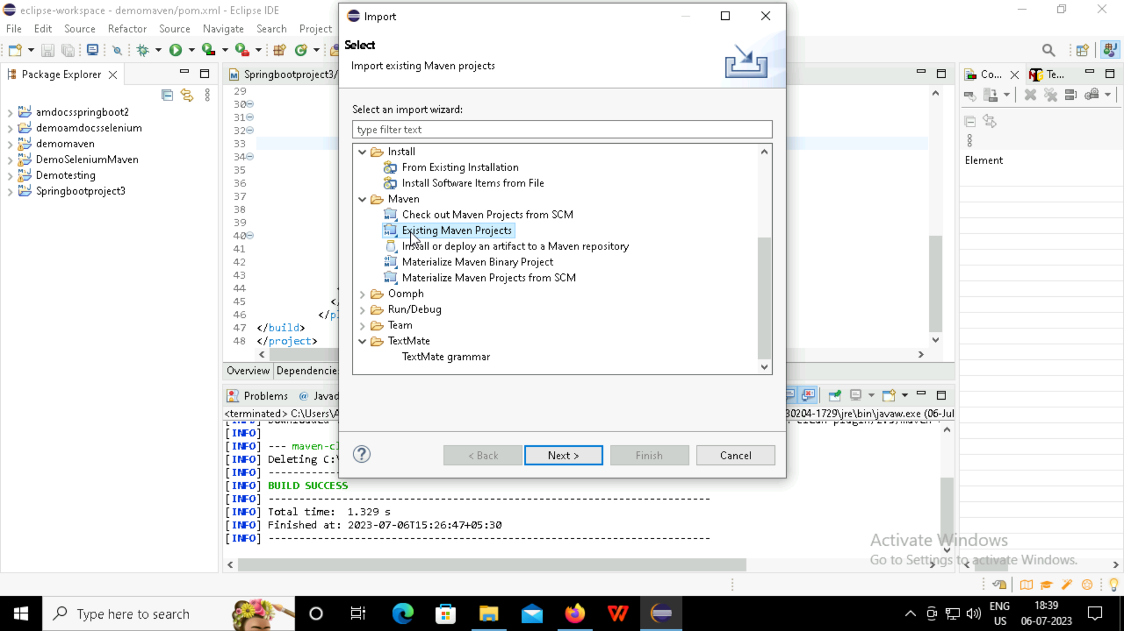

Slide 8
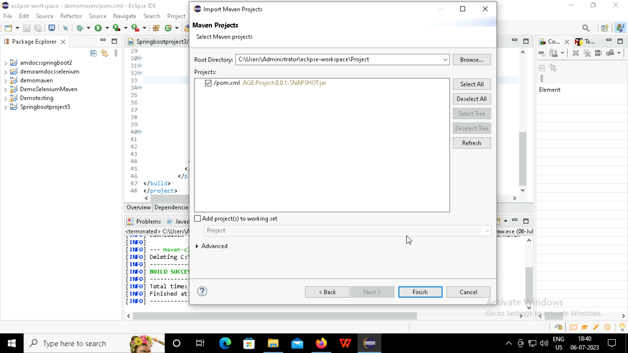

Slide 9
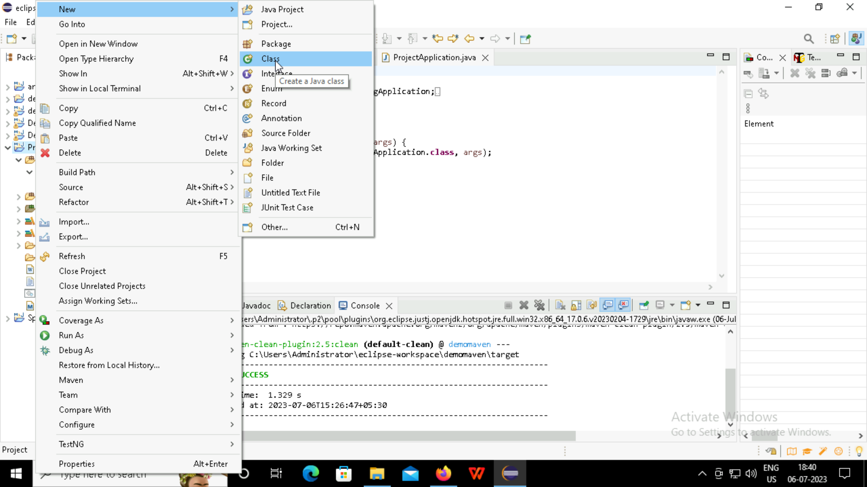
Creating the new class for the spring project

Slide 10
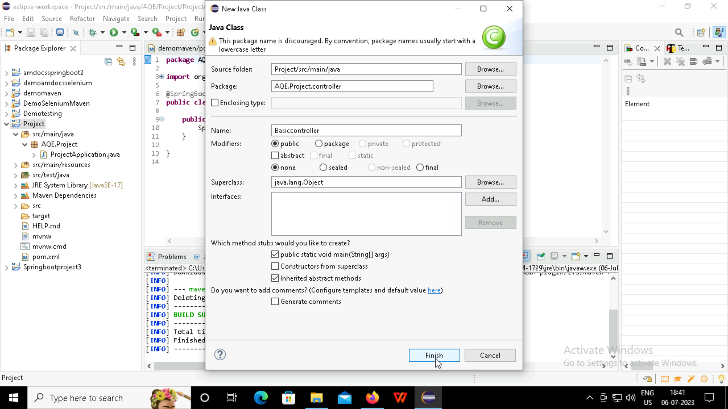

Slide 11
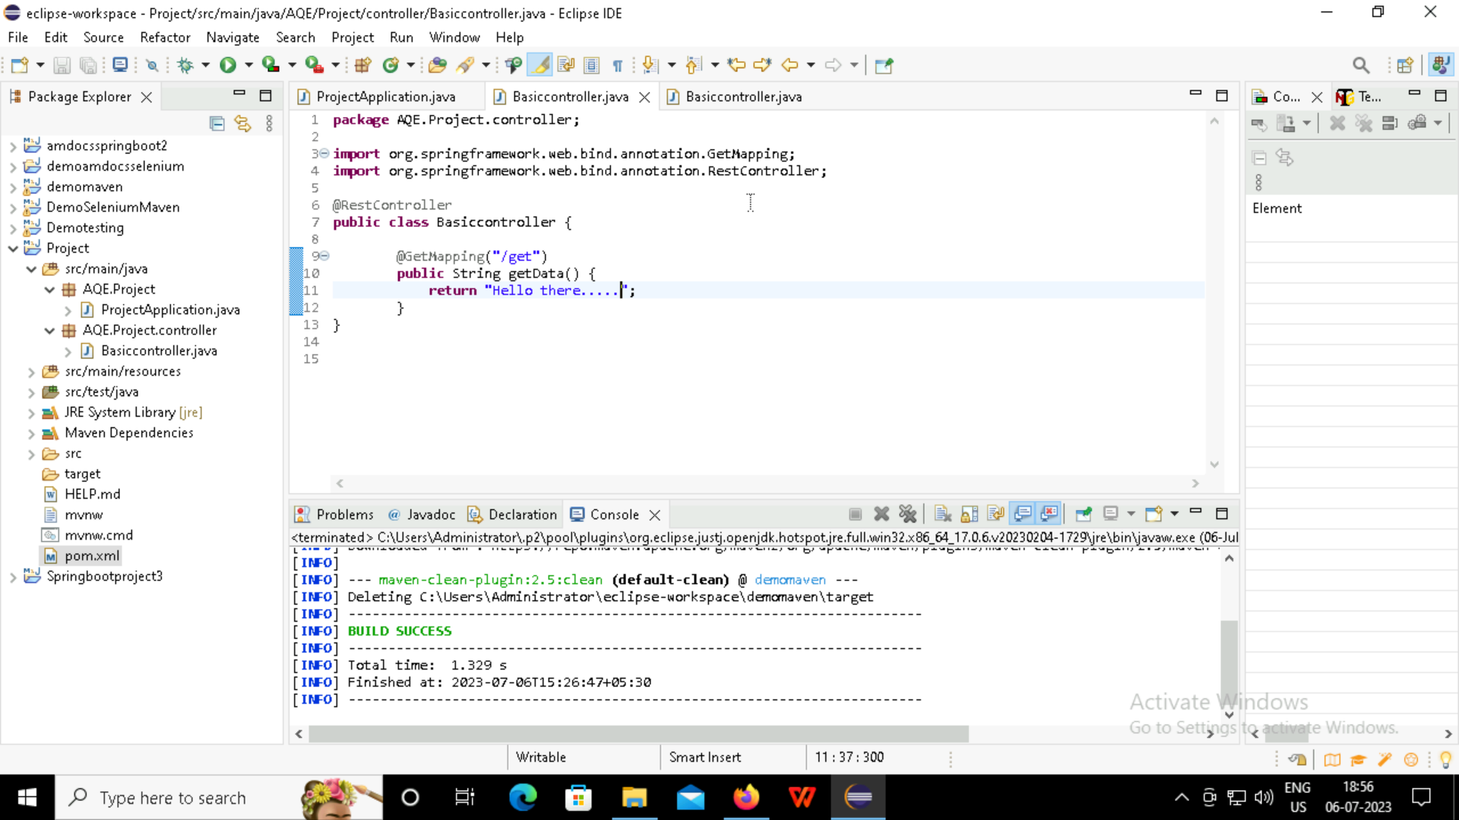

Slide 12
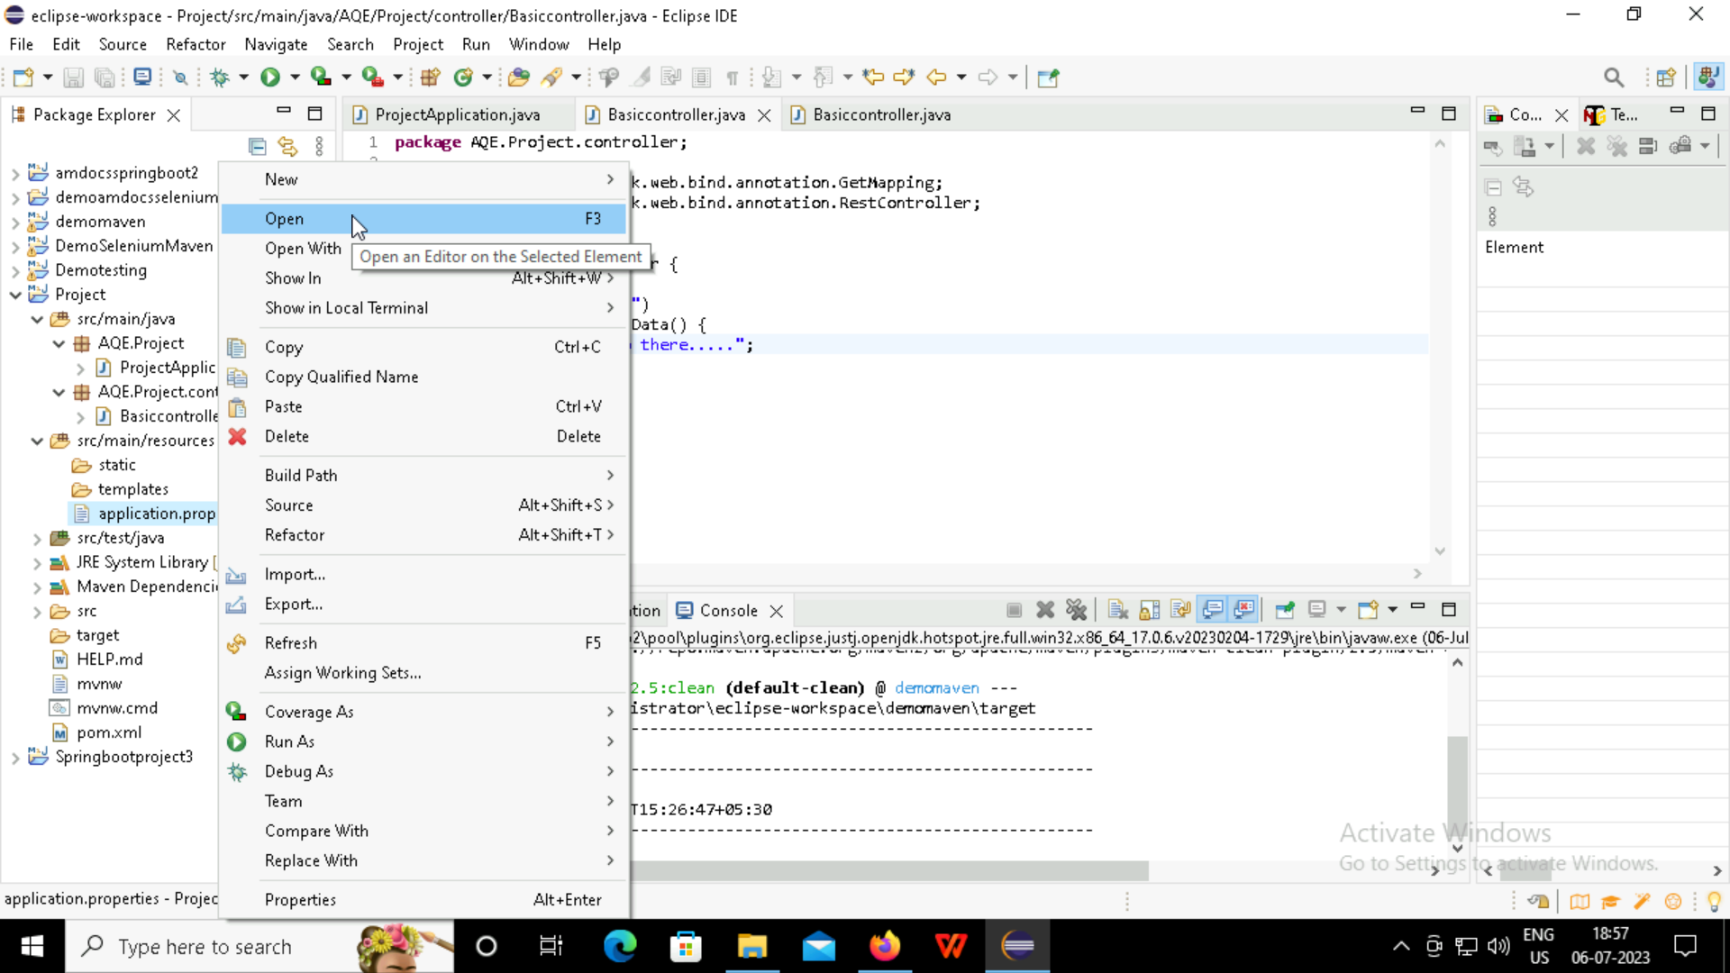

Slide 13
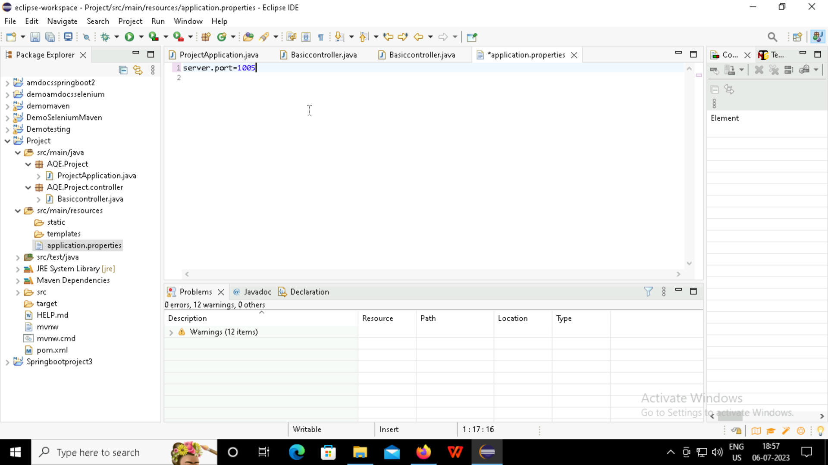
Server port number used to display the message in the browser

Slide 14
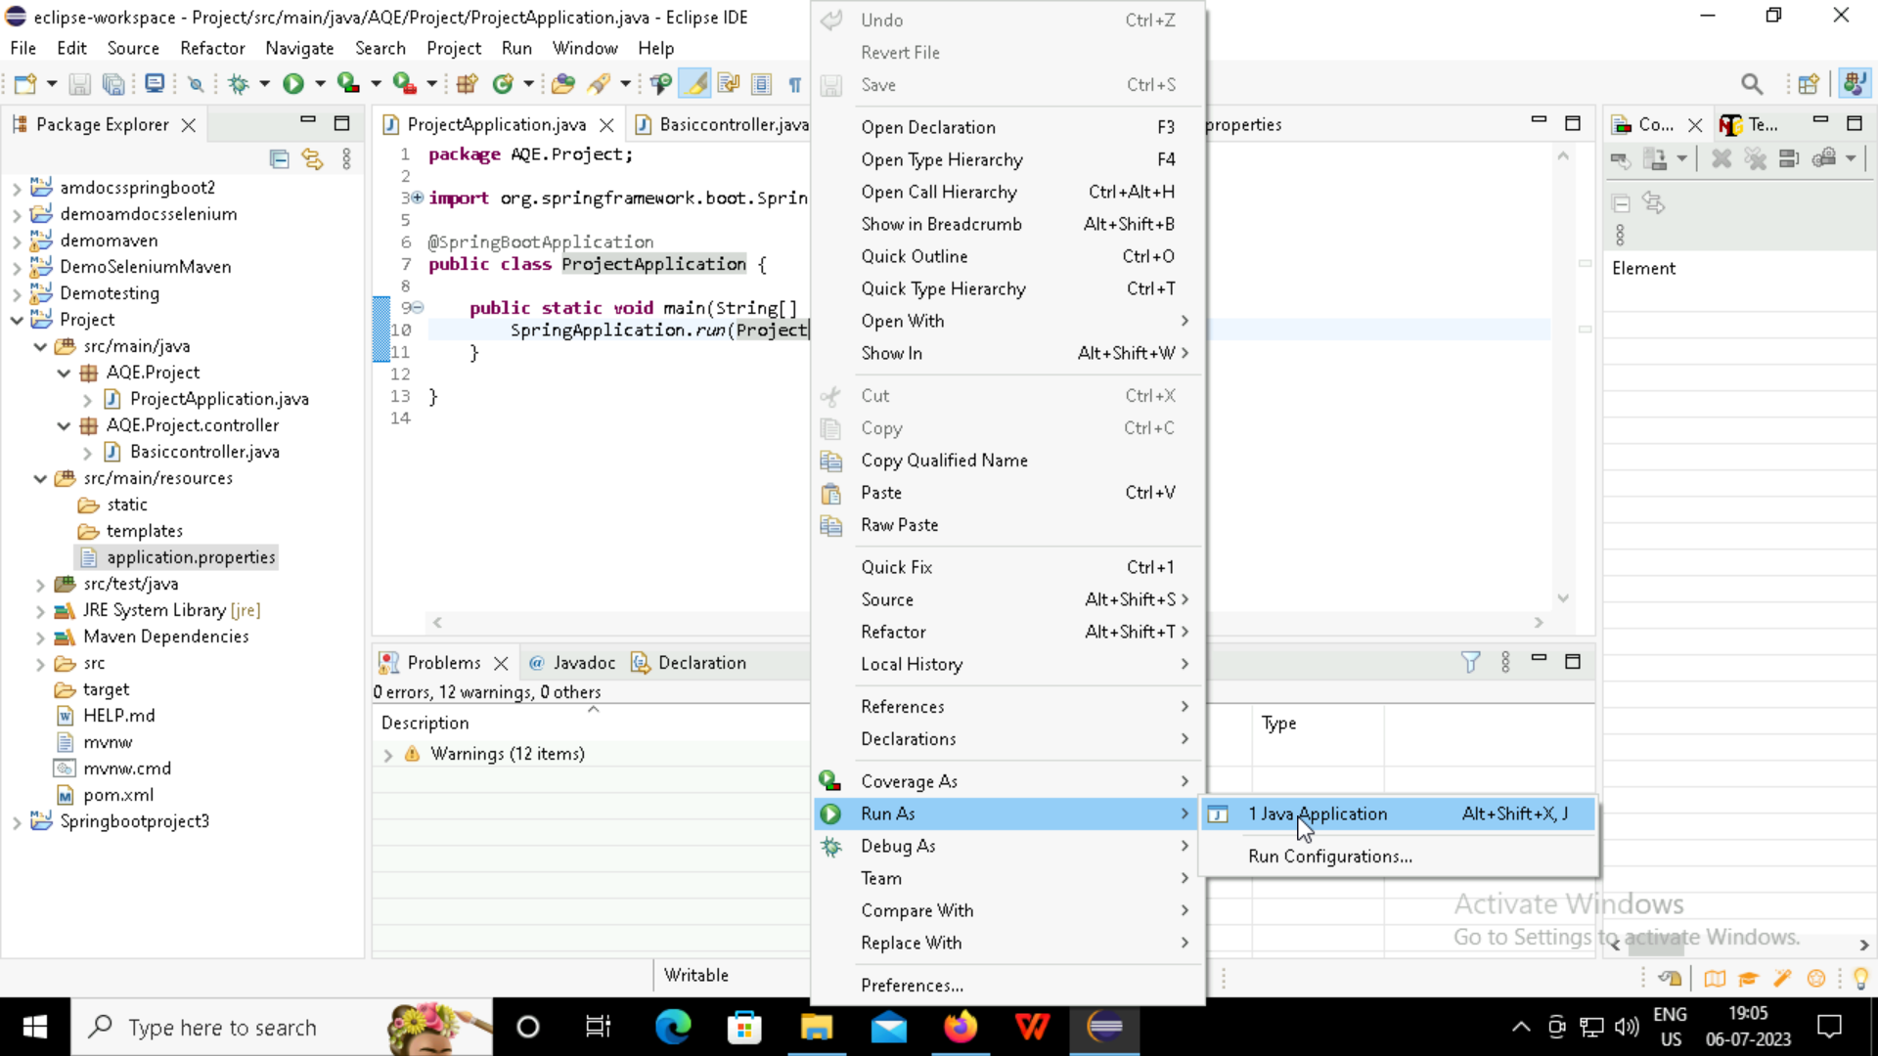

Slide 15
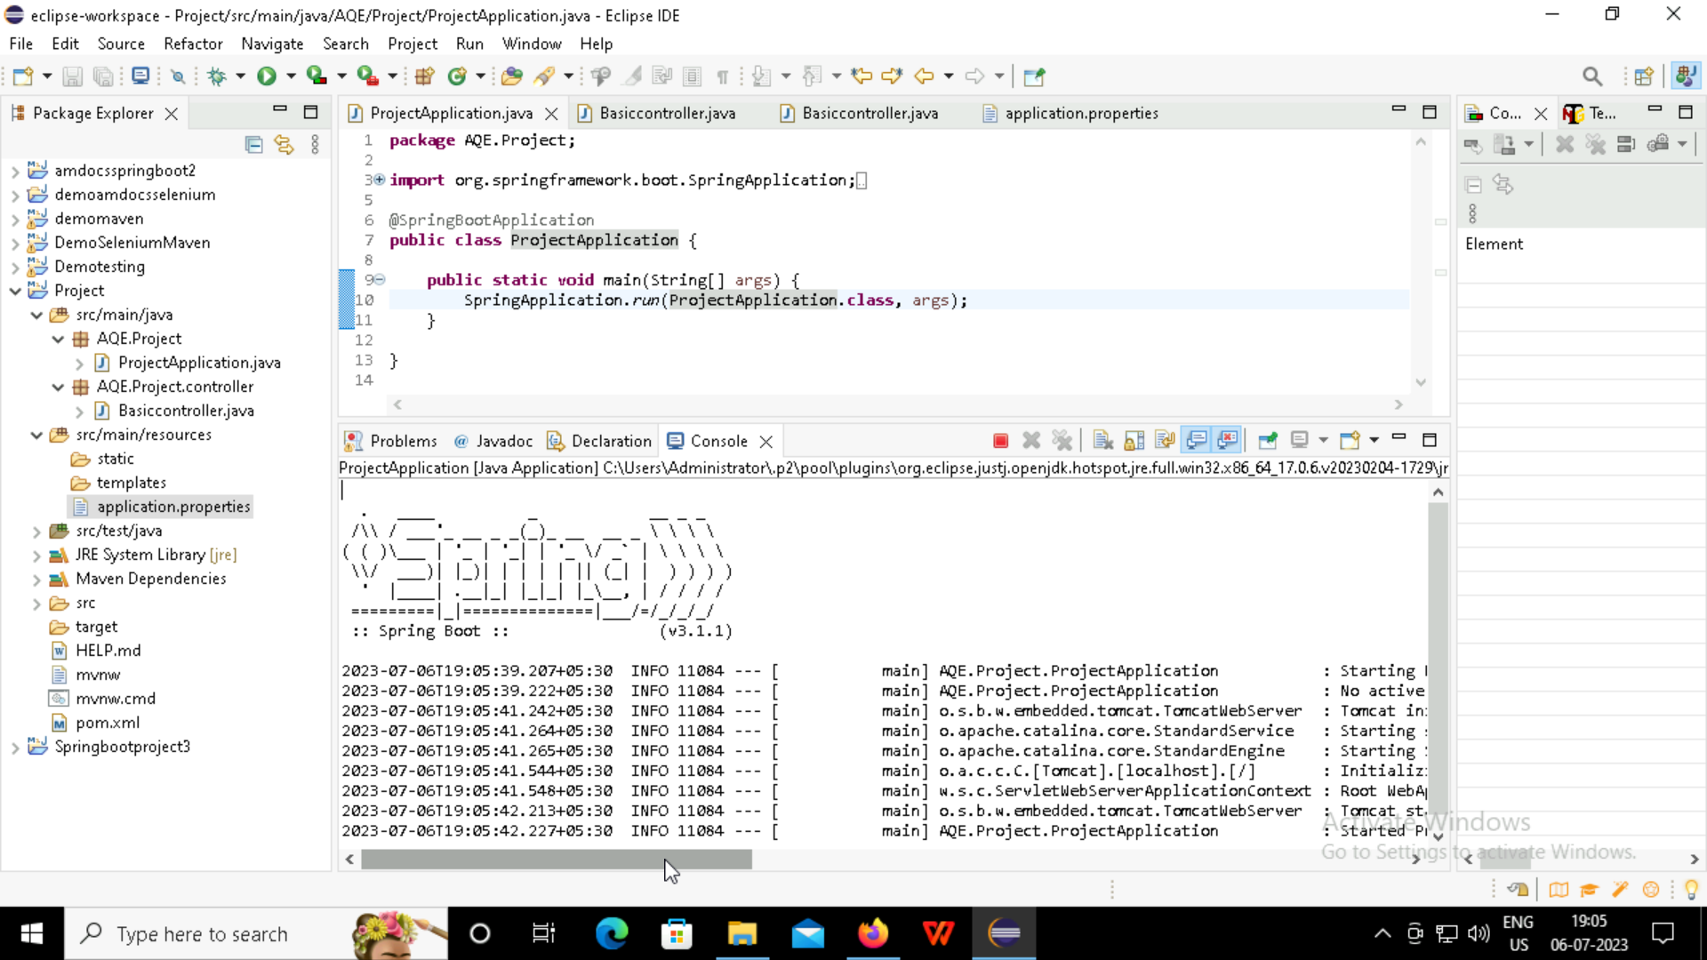

Slide 16
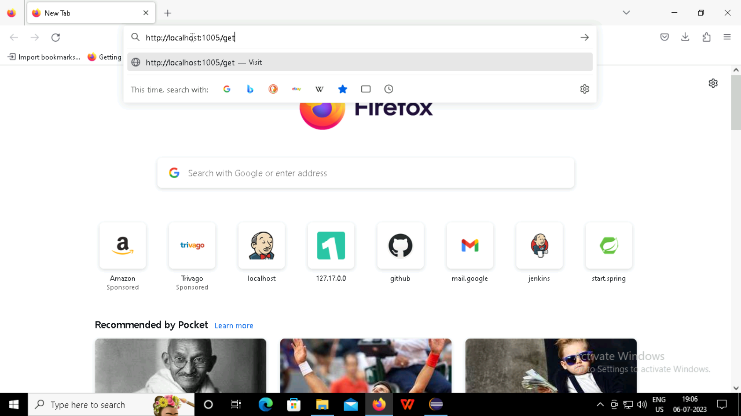

Slide 17
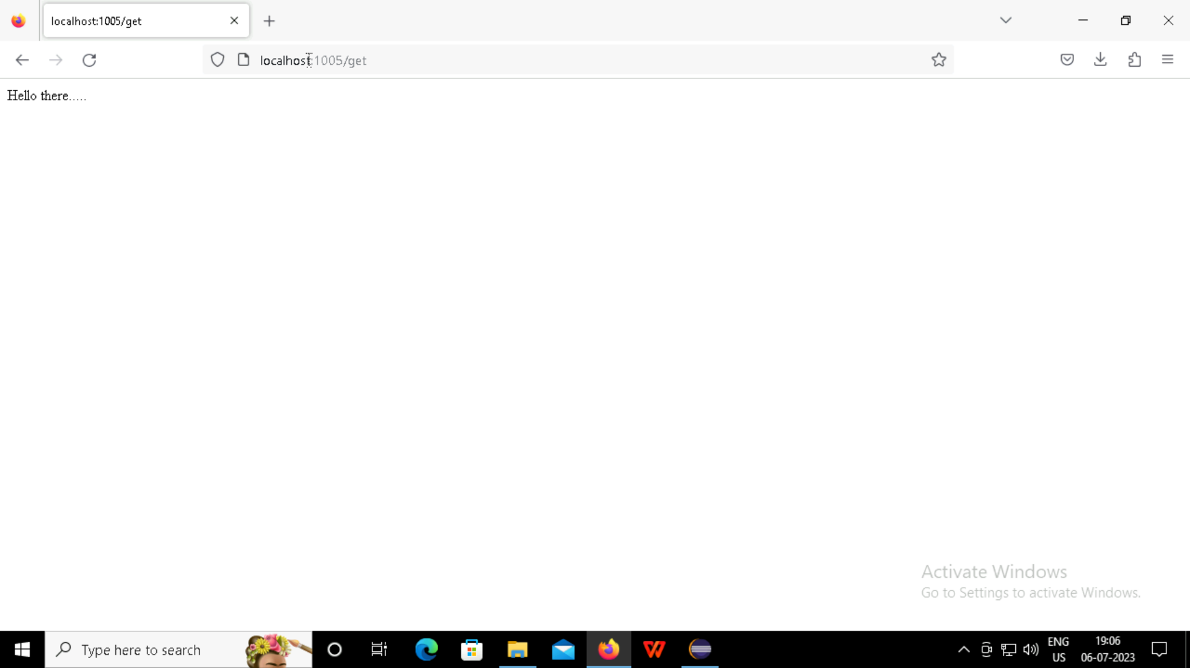

Slide 18

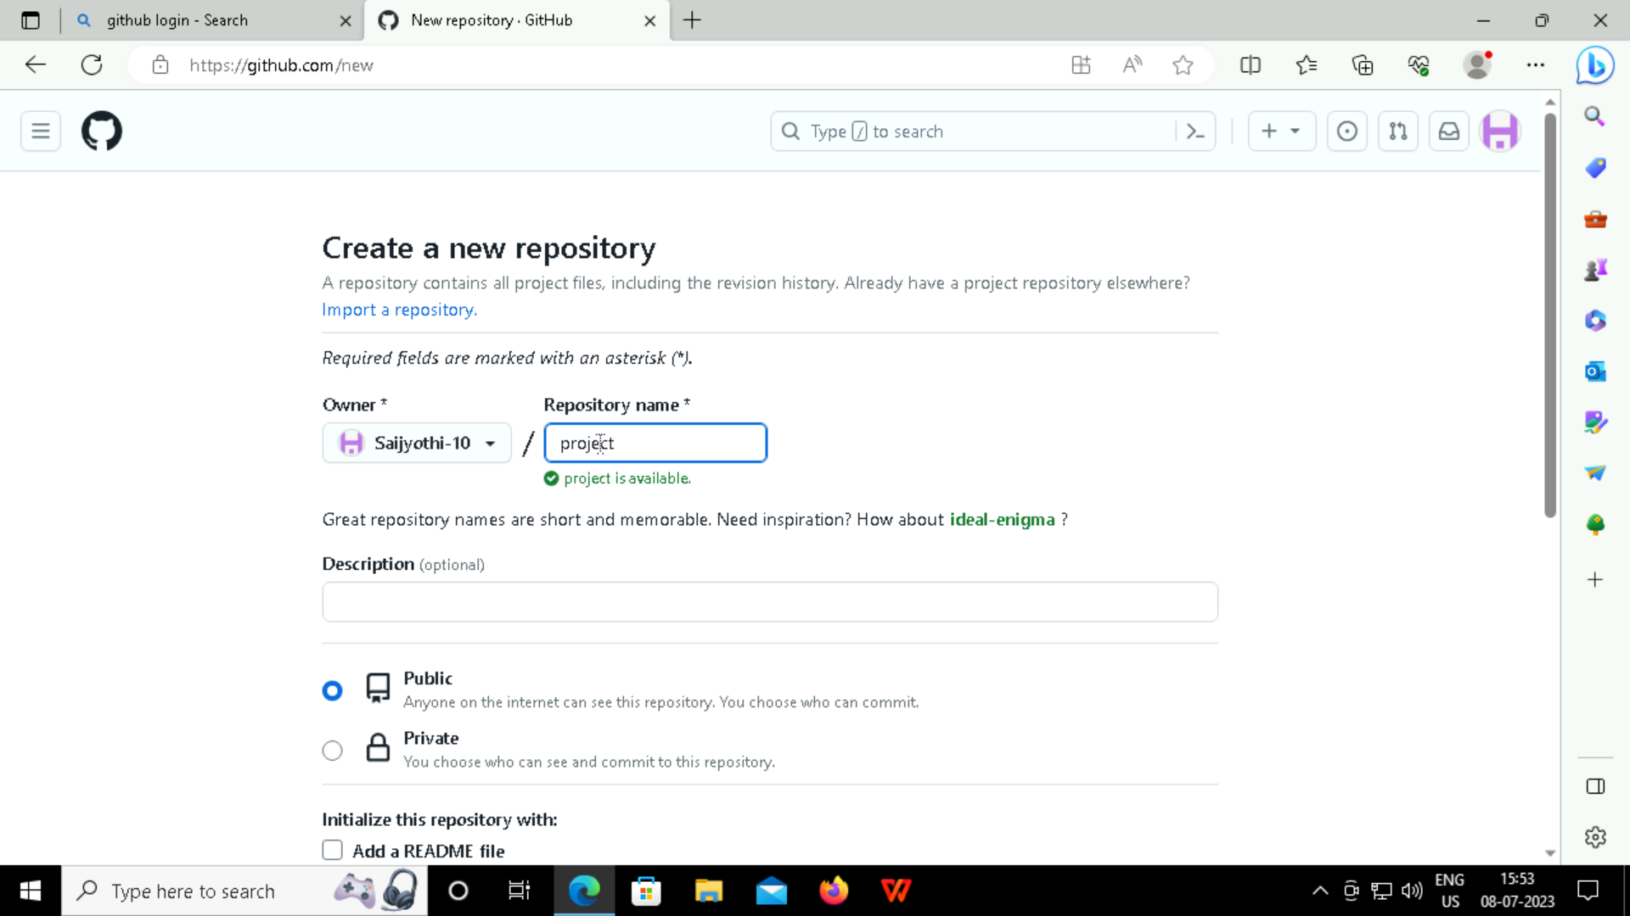
GitHub:
GitHub is a code hosting platform for version control and collaboration. It lets you and others work together on projects from anywhere.
Creating new repository in the GitHub

Slide 19
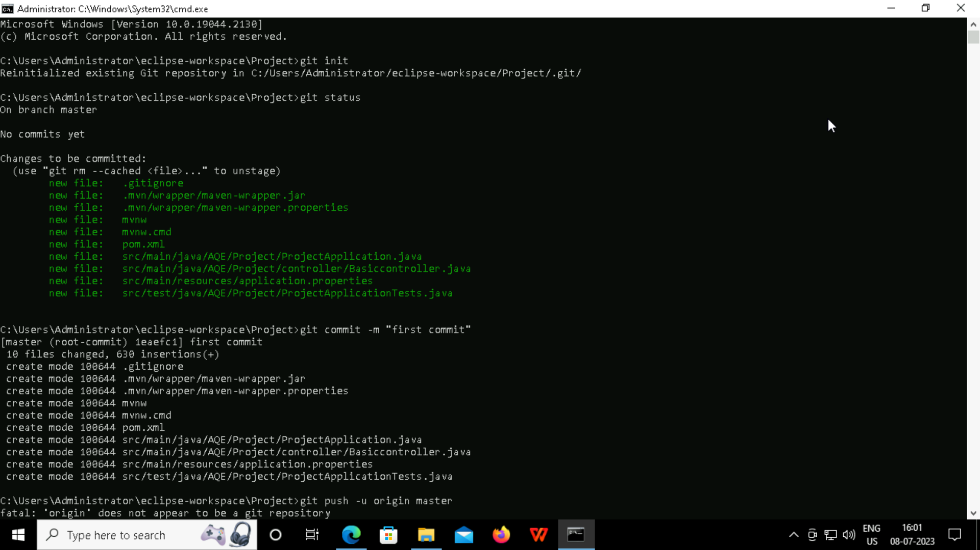
Pushing the spring project into the GitHub using command prompt

Slide 20
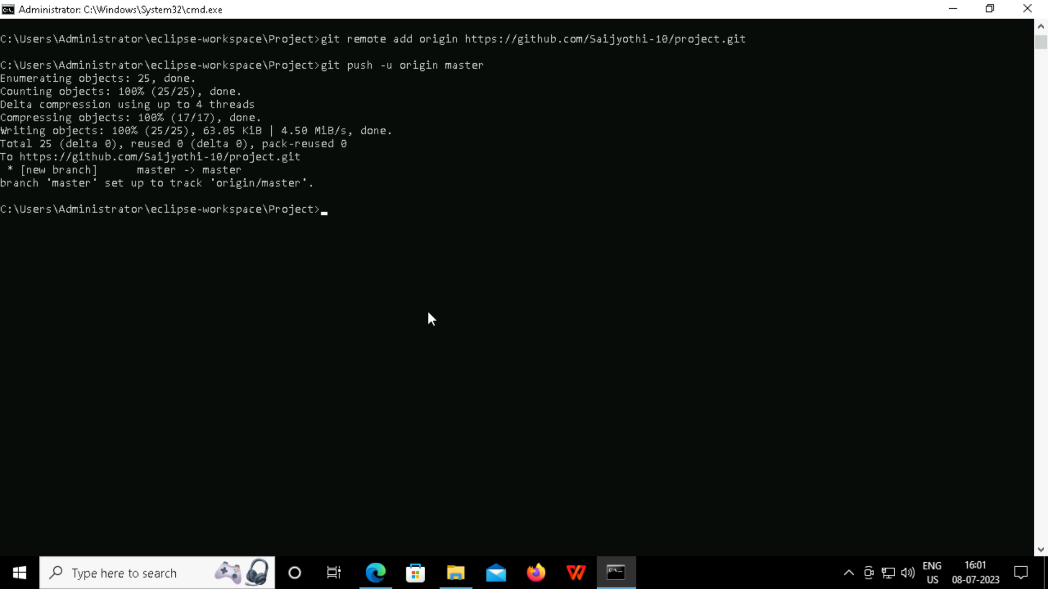

Slide 21
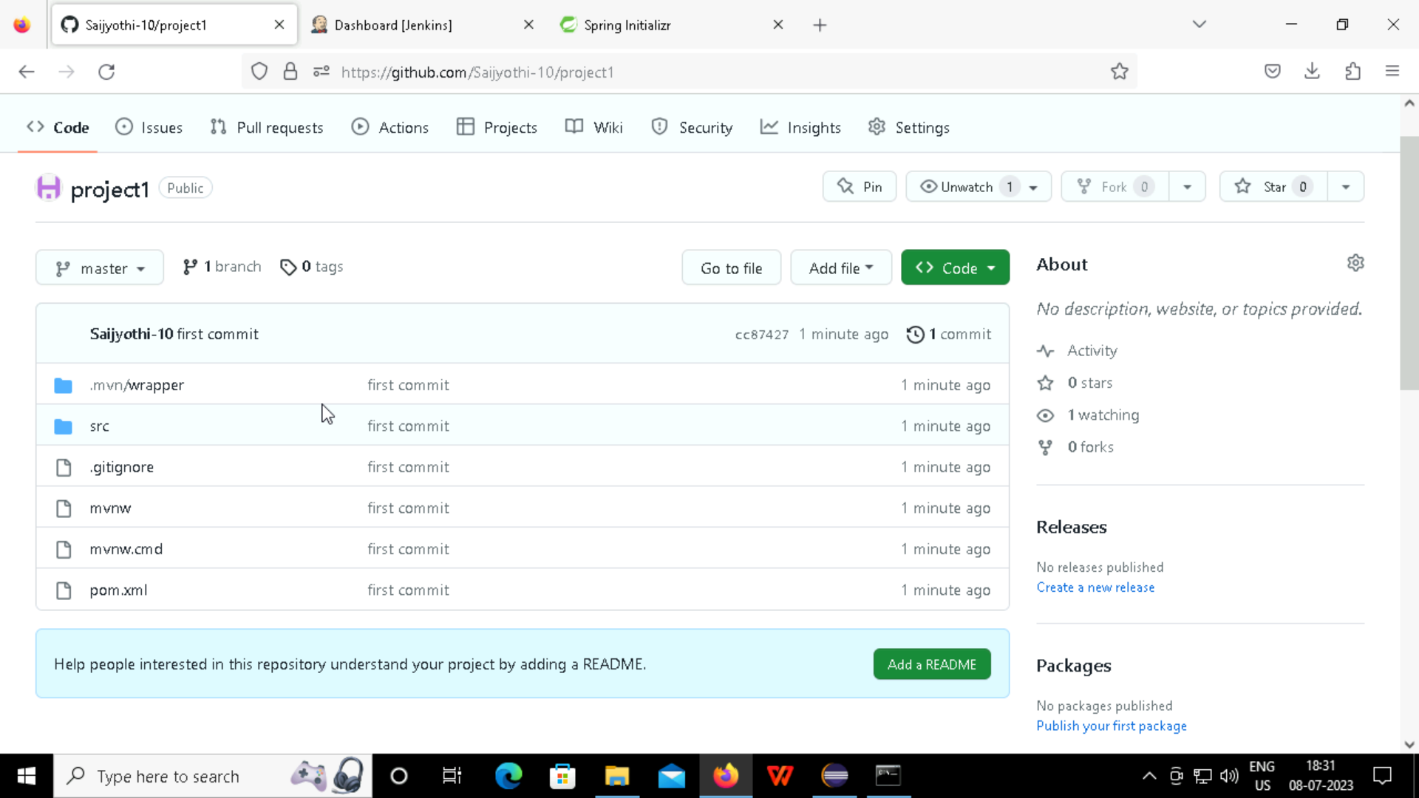

Slide 22
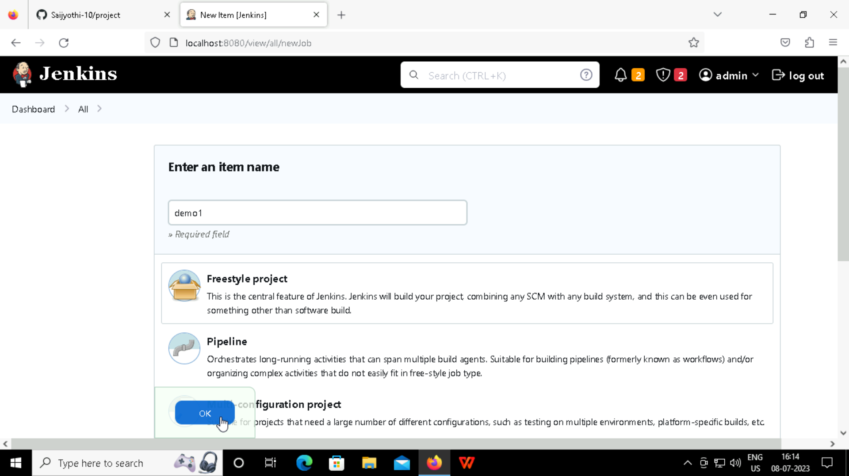
Jenkins:
Creating the freestyle project in Jenkins, to automated the workflows for building, testing, and deploying their applications.

Slide 23
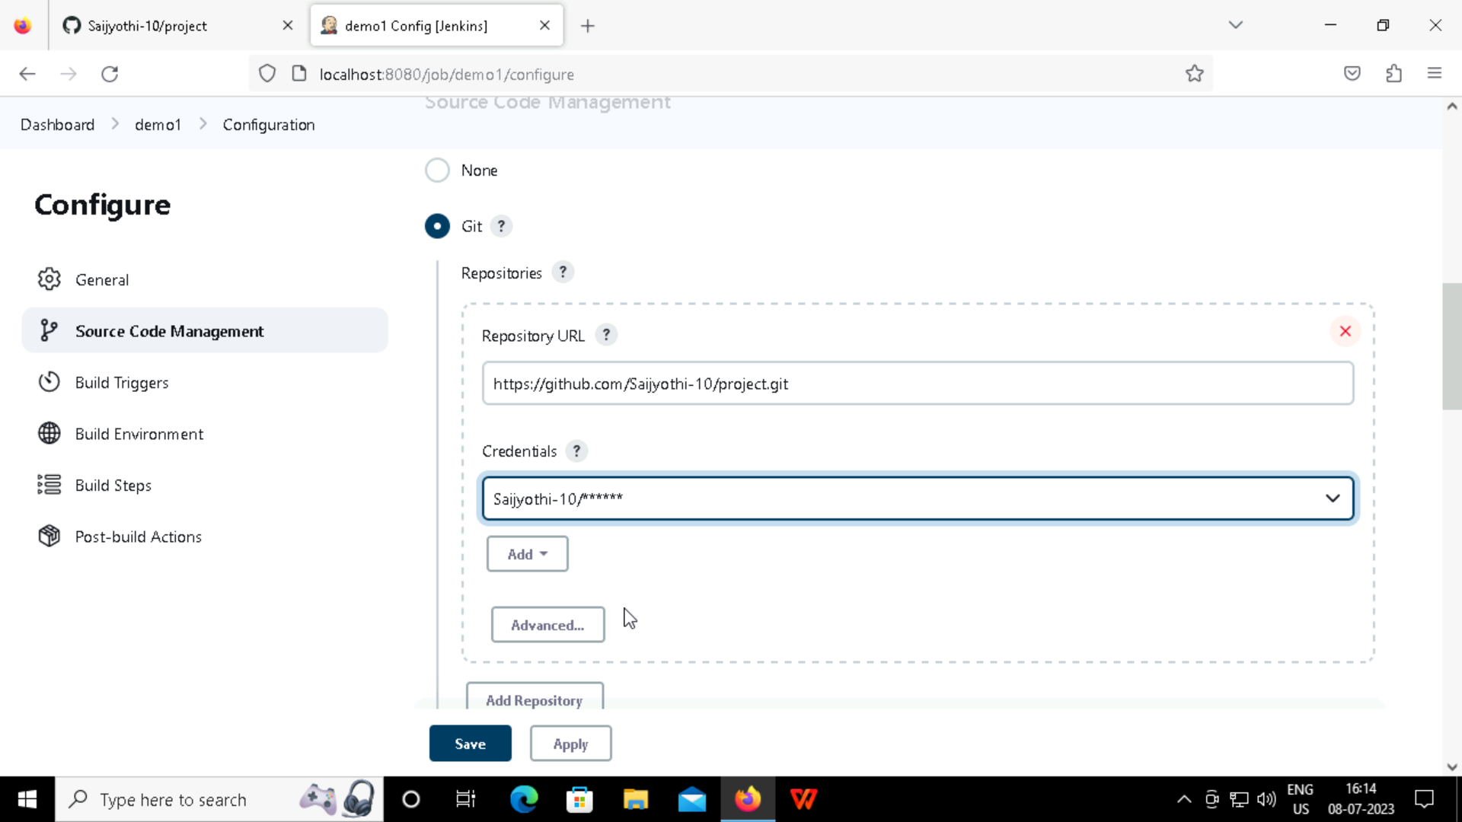

Slide 24
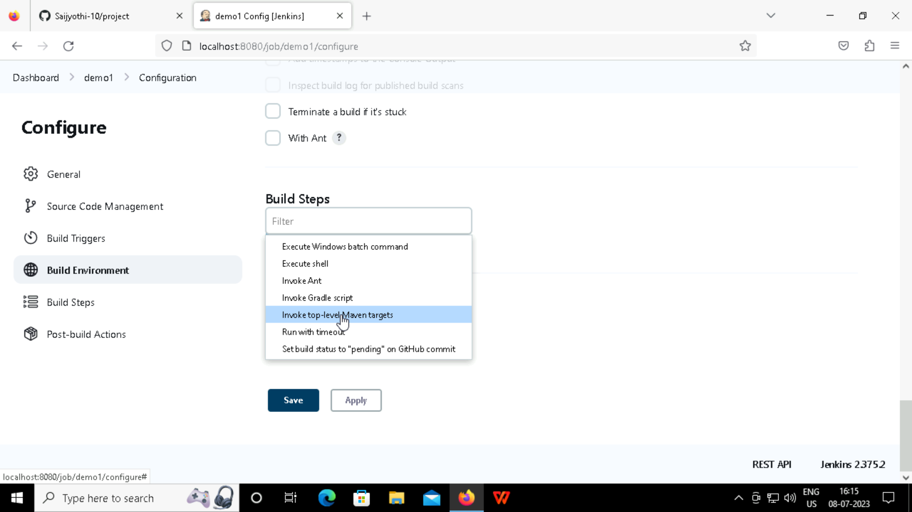

Slide 25
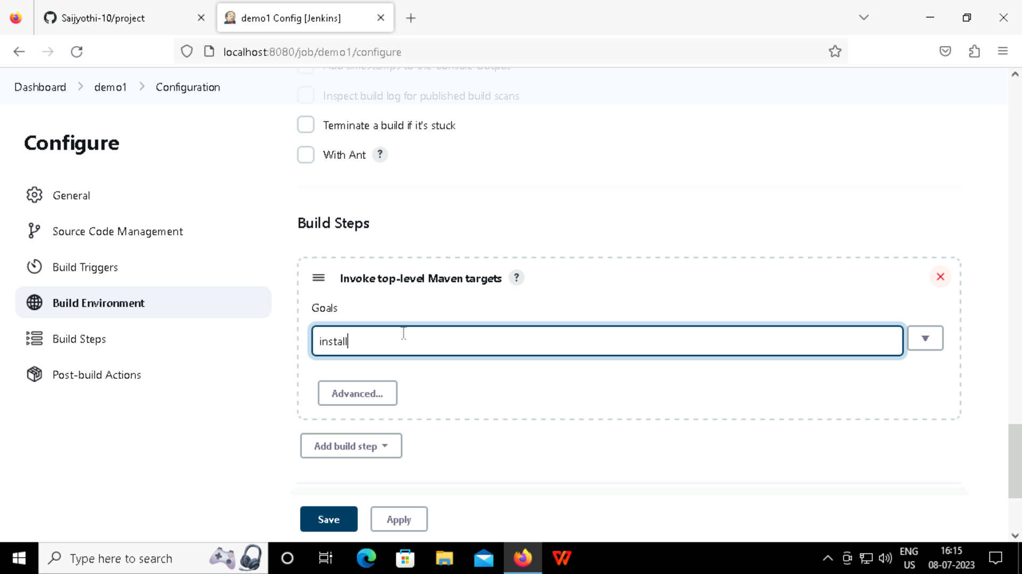

Slide 26
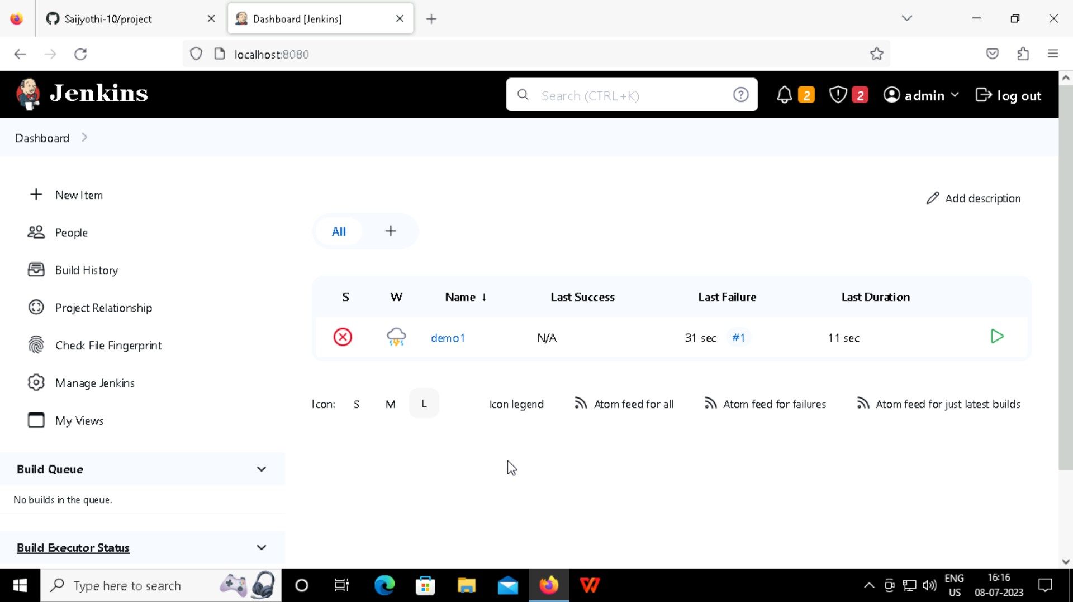

Slide 27
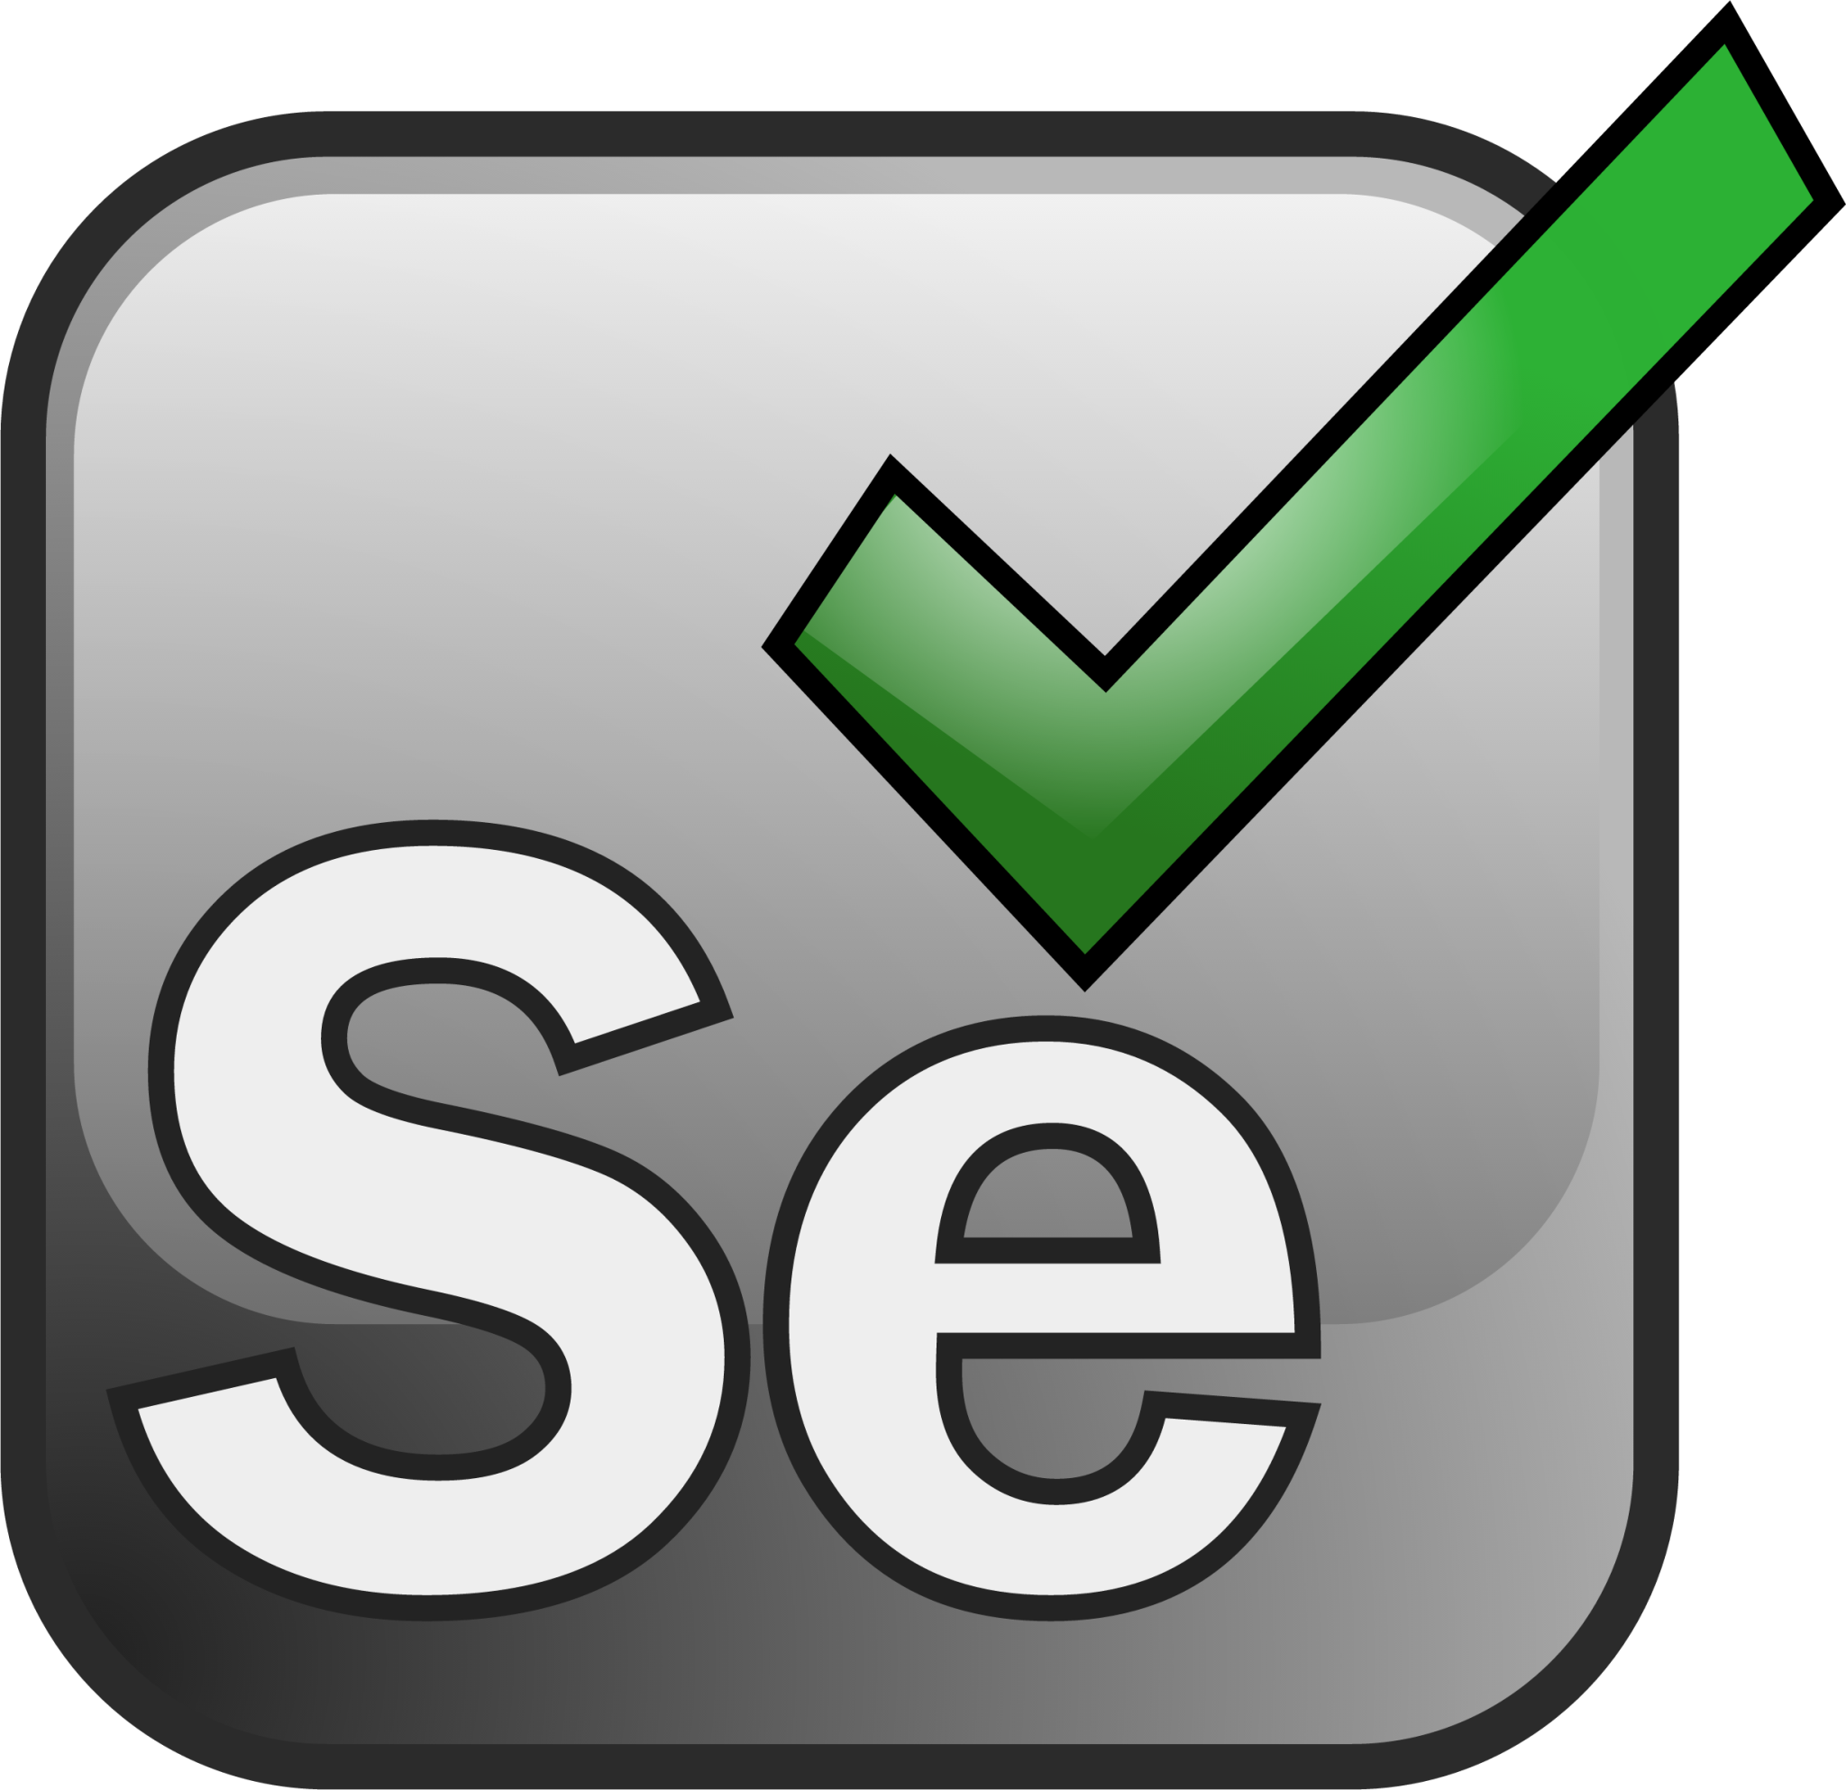
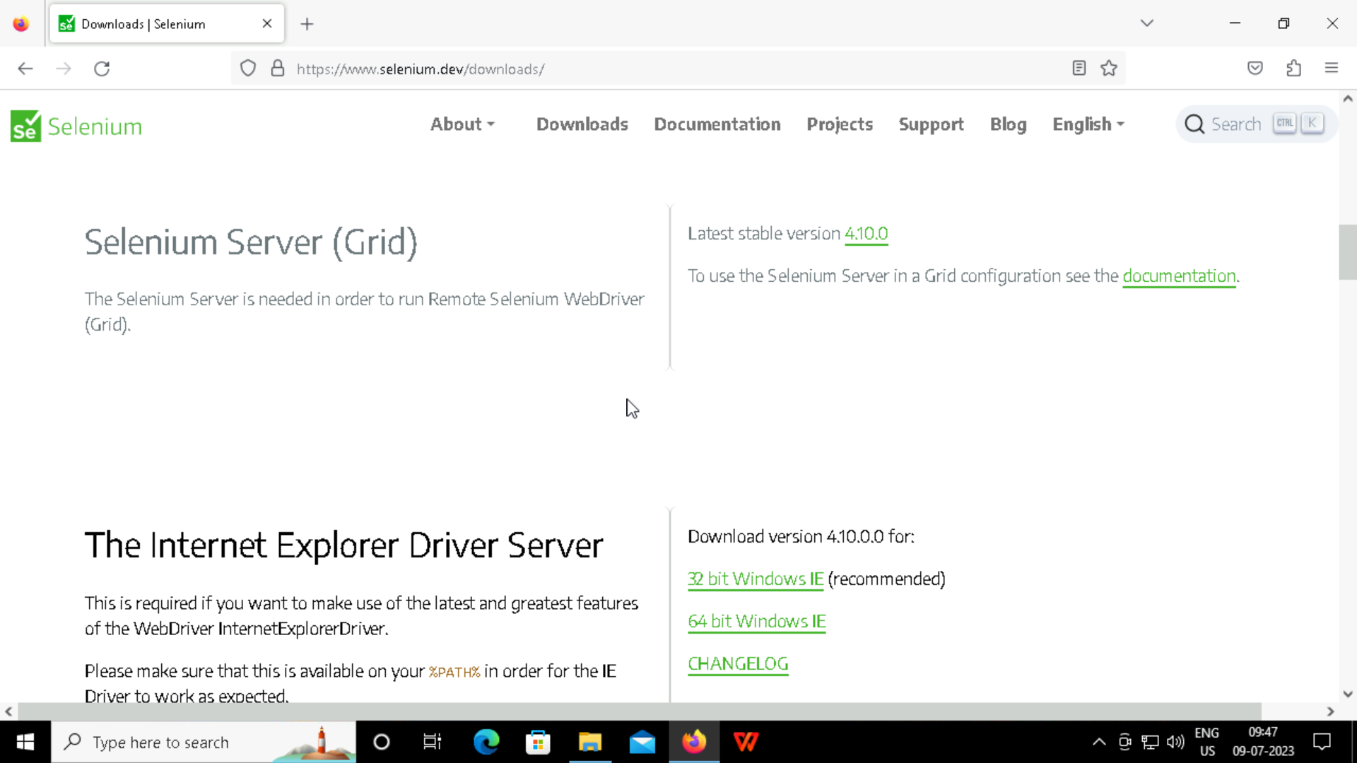
Selenium:
Selenium is used for Web Automations
Downloading the Selenium server to add the jar file in the eclipse

Slide 28
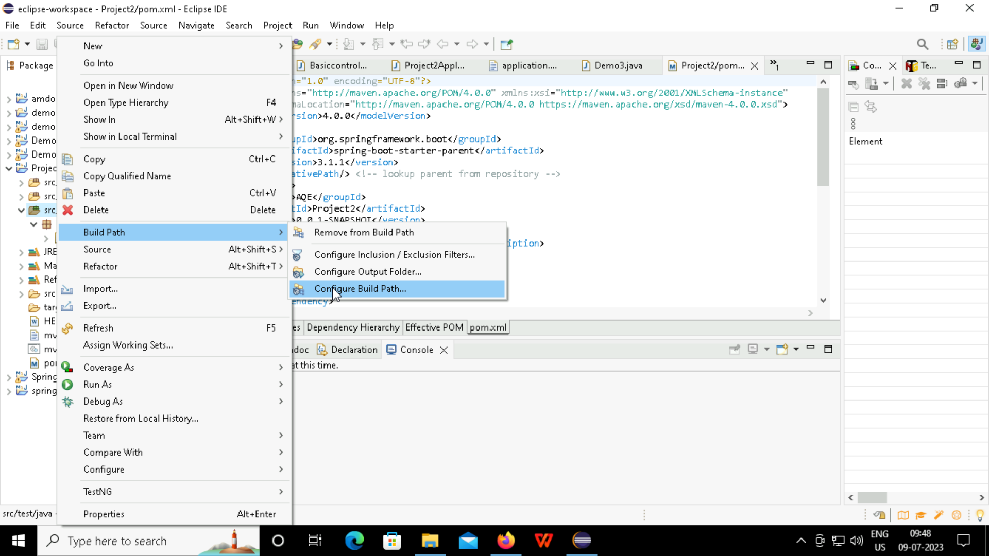
Configure the selenium to the eclipse

Slide 29
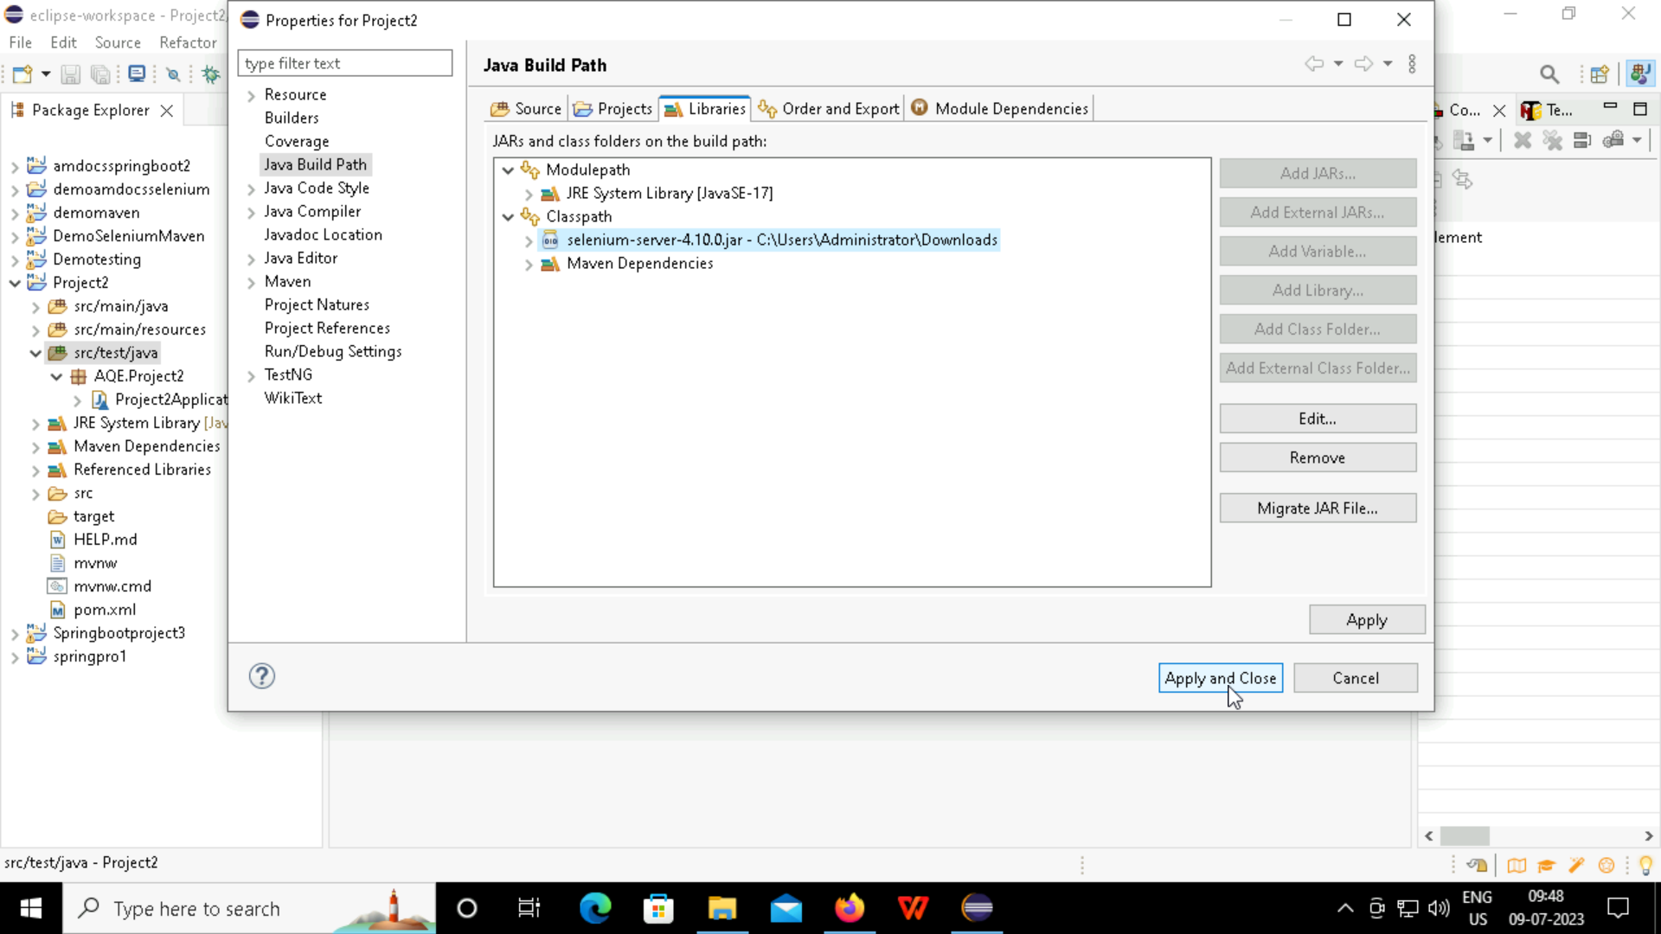

Slide 30
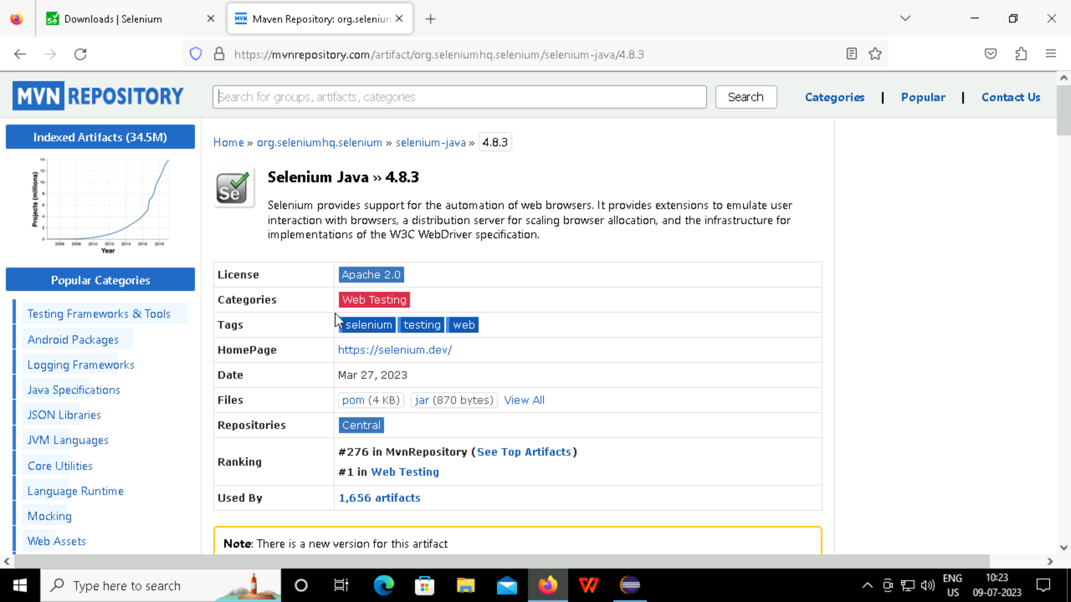
Maven is a product management tool
Adding the selenium dependencies to pom.xml using maven repository

Slide 31
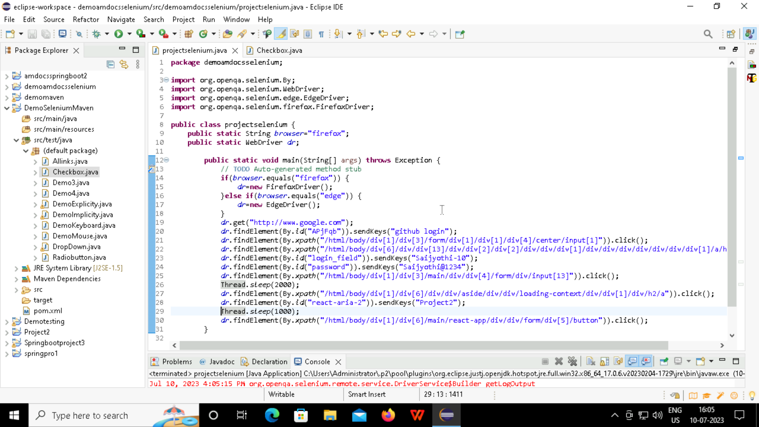
Creating a new repository in GitHub through Selenium

Slide 32
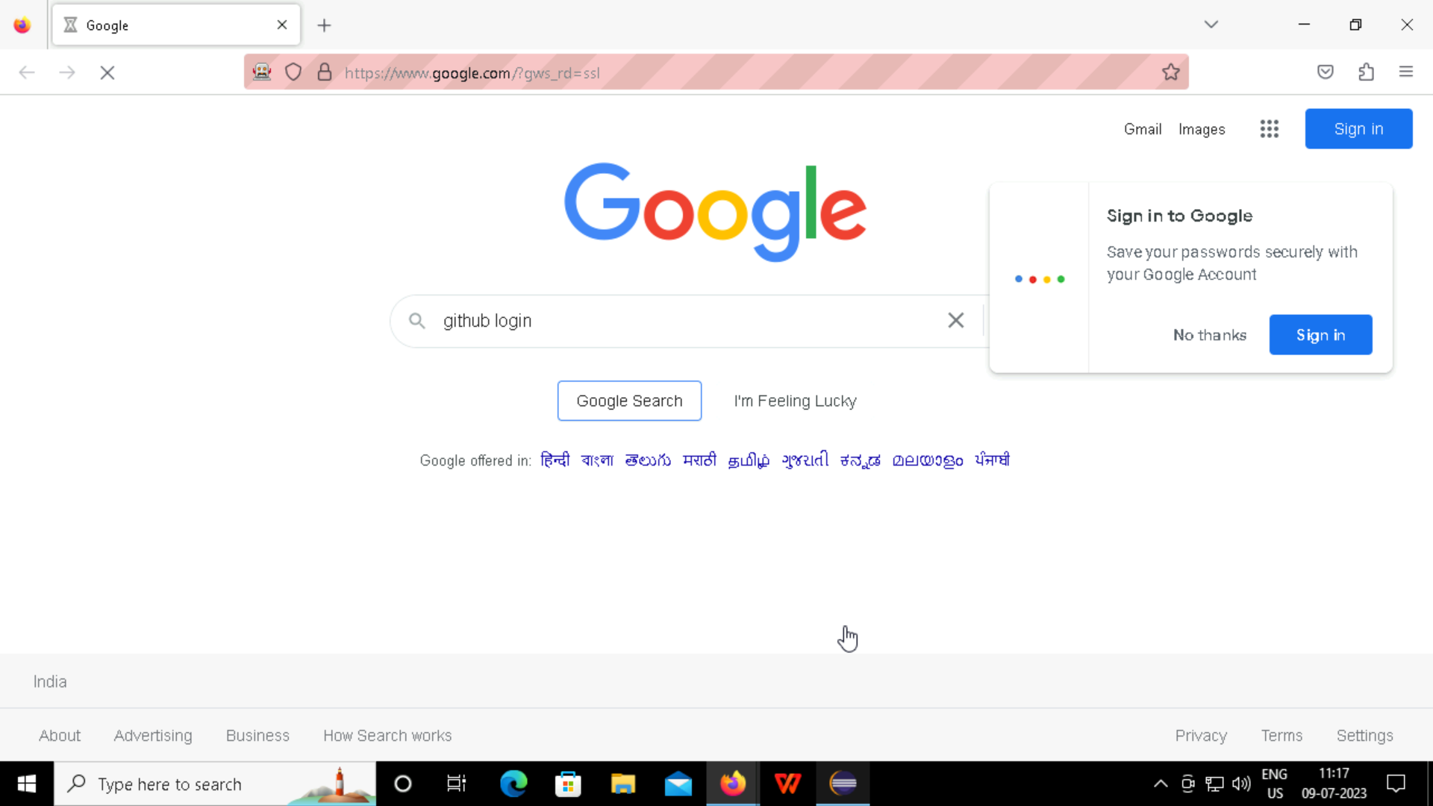

Slide 33
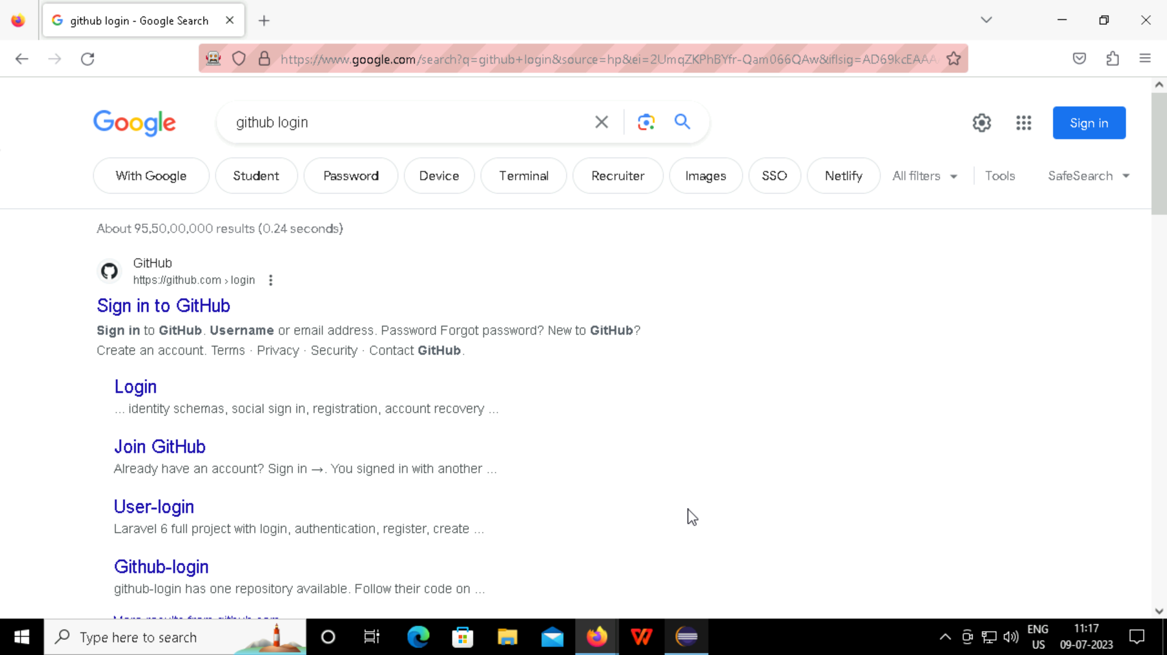

Slide 34
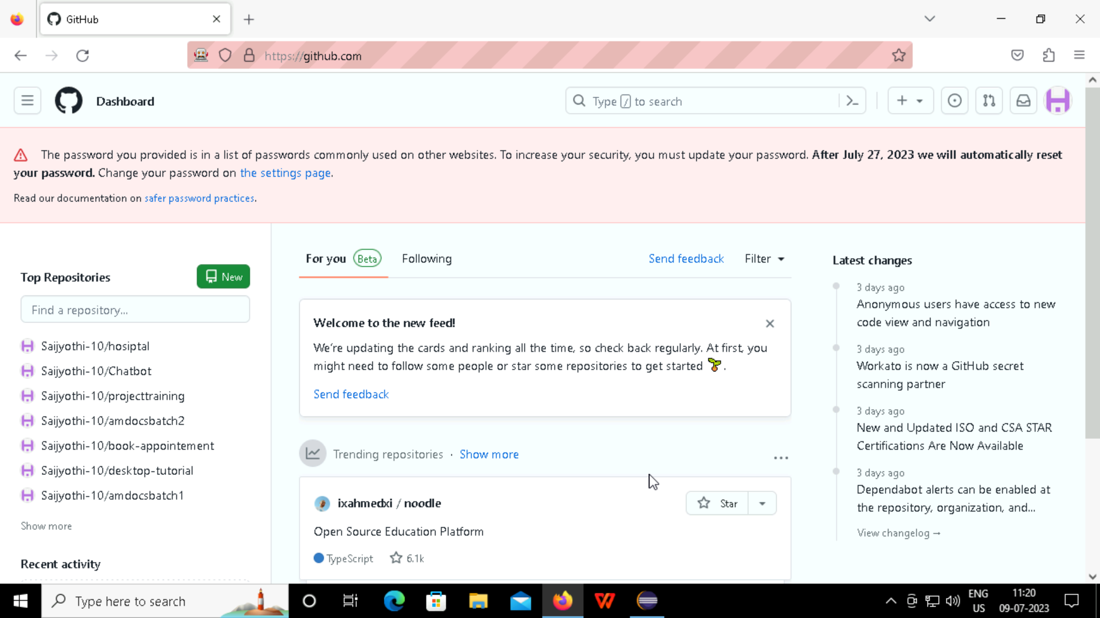

Slide 35
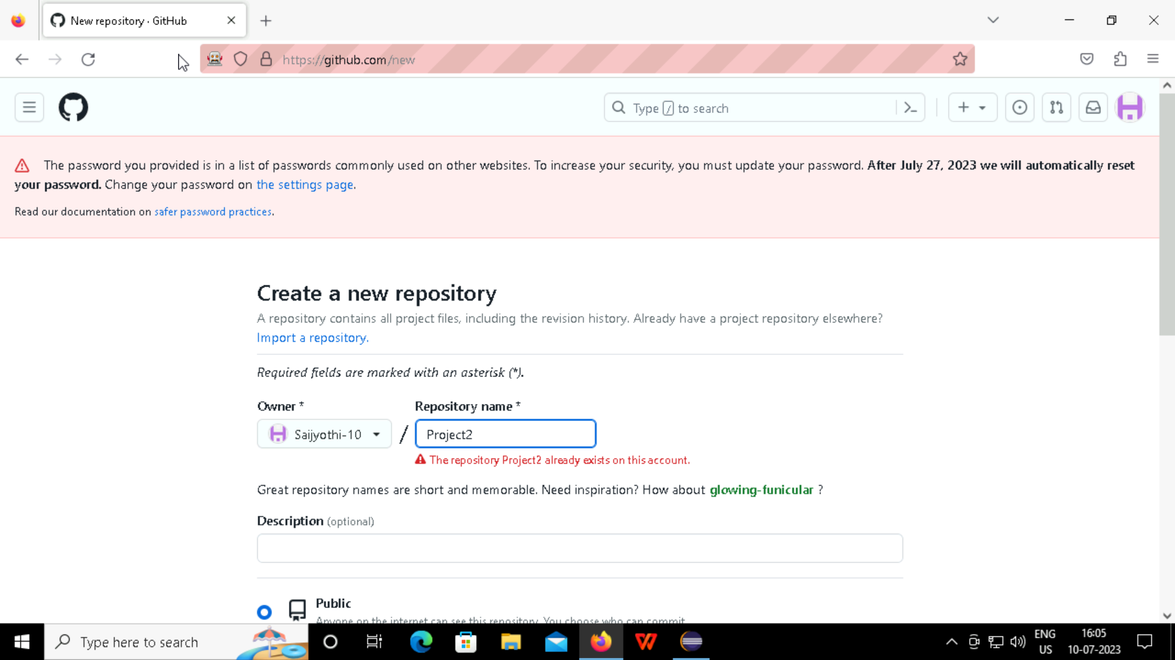

Slide 36
Thank You

